Slide 1
Reproduction
IGCSE Biology
Wendy Chai

Slide 2
Asexual reproduction
vs.
Sexual reproduction
This process results in the production of genetically identical offspring from one parent.
Examples:
Asexual reproduction in bacteria (also called binary fission)
Spore production in fungi
Tuber formation in potatoes.
The process involving the fusion (joining) of haploid nuclei of two gametes to form a diploid zygote, and the production of genetically different offspring.
Examples:
Most organisms.
Clone
Clone?

Slide 3
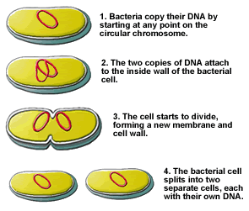
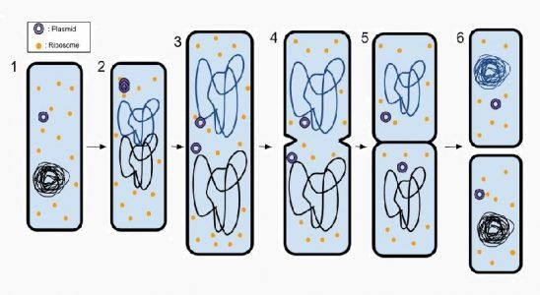
Asexual reproduction in bacteria
Binary fission is the process through which asexual reproduction happens in bacteria.
Binary fission is a relatively simple process, compared to mitosis, because binary fission does not involve reproducing organelles or complex chromosomes.
Notes:
Binary fission also describes the duplication of organelles in eukaryotes. Mitochondria and other organelles must reproduce via binary fission before mitosis so each cell has ample organelles.

Slide 4
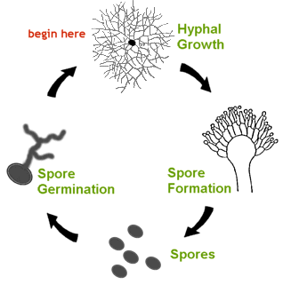
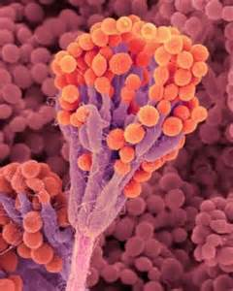

Spore production in fungi

Slide 5
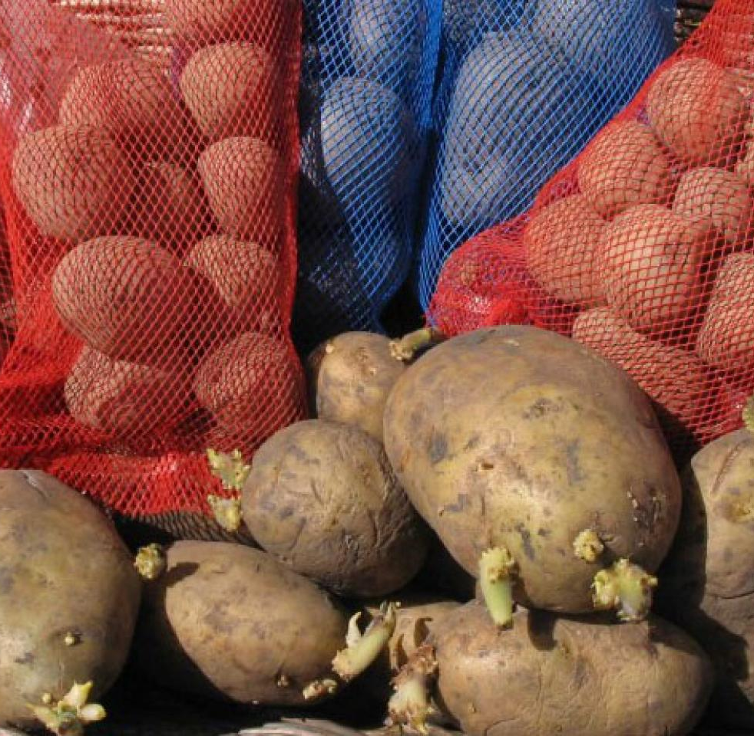

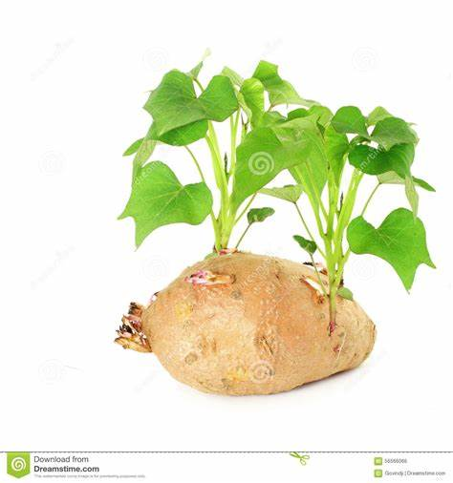
Tuber formation in potatoes

Slide 6
Asexual reproduction
Advantages:
Many offspring are produced faster (in a short time).
Only one parent is needed (and this saves energy).
They are often well adapted to the environment they live in.
Able to maintain desirable features/ traits.
Disadvantages:
Less genetic variation
Adaptation to changes in the environment or a new environment is difficult.
Because they are genetically identical, if one individual suffers from a disease, all individuals will suffer.
Does not favor evolution

Slide 7
Sexual reproduction
Advantages:
Sexual reproduction produces variation, so individuals have a wider range of characteristics.
More able to adapt to changes in environment or a new environment.
More likely for some individuals to survive a new disease.
Very important for evolution.
Disadvantages:
Often fewer offspring are produced (in a longer time).
Higher energy cost.

